Slide 1

Phonics Workshop
Wednesday 2nd October 2019

Slide 2

Did you know…?
The English language has:
26 letters
44 sounds
Over 100 ways of spelling those sounds
It is one of the most complex languages to learn to read and spell.

Slide 3

What is Phonics?
Phonics is the teaching of reading by developing awareness of the sounds in words and the corresponding letters used to represent those sounds.
Phonics learning relies on children being able to hear and distinguish the sounds within words.
Listening skills begin at birth and there are lots of things that parents and carers can do to support these skills.

Slide 4
The Jargon
Phoneme - Any one of the 44 sounds which make up words in the English language.
Grapheme – How a phoneme is written down. There can be more than one way to spell a phoneme. For example, the phoneme ‘ay’ is spelt differently in each of the words ‘way’, ‘make’, ‘fail’, ‘great’, ‘sleigh’ and ‘lady’.
Blending – Putting together the sounds in a word in order to read it,
e.g. ‘f – r – o – g = frog’
Segmenting – Breaking a word into its constituent sounds in order to spell them, e.g. ‘frog = f – r – o – g’ (Also known as ‘sounding out’)

Slide 5

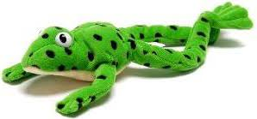
RWI
We use RWI for Phonics – 25 minutes every day
            This is Fred. He helps the children to read but can only read sounds. We have to help him blend words together.

Slide 6
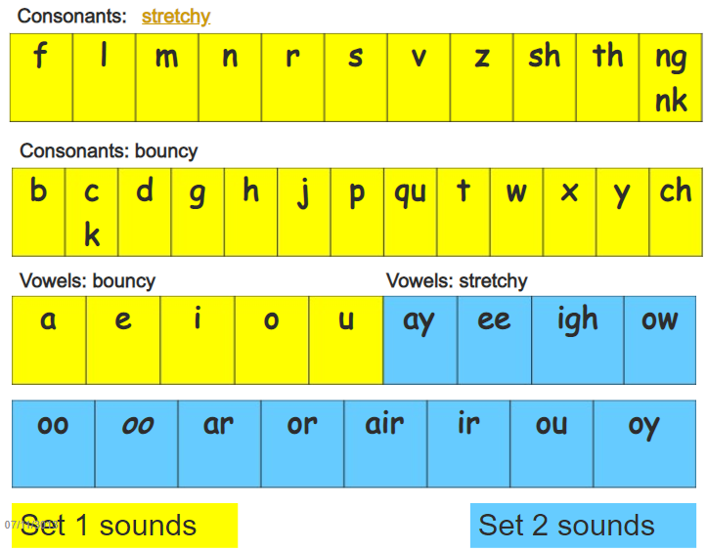
RWI
We teach children that sounds can be ‘stretchy’ or ‘bouncy’
The children use this knowledge to help them with segmenting and blending.

Slide 7
Segmenting and Blending
Pure sounds – ‘m’ not ‘muh’ or ‘s’ not ‘suh’
Segmenting – breaking down the word:
Queen
Qu ee n
Blending – building words phonemes in order to read

Slide 8

Becoming ‘a reader’
Phonics – decoding by blending the sounds in words to read them
Language comprehension- understanding what the word means within the context it appears
Reading for meaning

Slide 9
Reading for Meaning
How do you think the story will end? Why?
Why has the character started to behave that way?
How/where does the story start?
Which is your
favourite/worst/
funniest/scariest part
of the story? Why?
Which words has the
author used to make
you feel happy/angry/
worried/frightened/
nervous?

Slide 10
How can I help my child to read?
1. Time – make time each day to sit with your child and read, even if it is only for 5 minutes. Little and often is key!
2. Support your child with reading new words by:
Saying each sound in the word from left to right.
Blending the sounds by pointing to each letter, i.e. /b/ in bat, or letter group, i.e. /igh/ in sigh, as you say the sound, then run your finger under the whole word as you say it.
Try to ensure that you enunciate the sound accurately.
3. Talk about the meaning if your child does not understand the word they have read. Discuss the story – what is happening? What might happen next? Why do you think that?
4. Work at your child’s pace.
5. Always be positive and give lots of praise and encouragement.

Slide 11
Further Support
Why should I read with my child at home?
Phonics made easy
Free e-books to share at home

