Slide 1

E-safety
Parent Workshop
Helping to keep your children safe online
November 2019

Slide 2
Aims of the session
Reflect on the potential risks of internet use for children.
Discuss the importance of communication with children about the time they are spending online.
Understand how to set up parental controls on home and mobile devices.
Know what to do if your child encounters problems online.
Q&A

Slide 3
How many of these acronyms/abbreviations do you know?
LOL –
BRB -
ASL –
CD9 –
KPC –
(LM)IRL -
P911/P999
PAW -
POS/MOS -
RU/18 –
WYRN -
Zerg -

Slide 4
How many of these acronyms/abbreviations do you know?
LOL – laugh out loud
BRB – Be right back
ASL - age, sex, location (could mean your child is using an anonymous chat room)
CD9 - Code 9 (meaning parents are around)
KPC - keep parents clueless
(LM) IRL – (Let’s meet) in real life.
P911/P999 - parent alert
PAW - parents are watching
POS/MOS - parents over shoulder/mum over shoulder
RU/18 - are you over 18?
WYRN - what's your real name?
Zerg - to gang up on someone

Slide 5
Age restrictions?
Instagram
Facebook
Twitter
Whatsapp
TikTok
YouTube
iTunes
Spotify
Kik

Slide 6
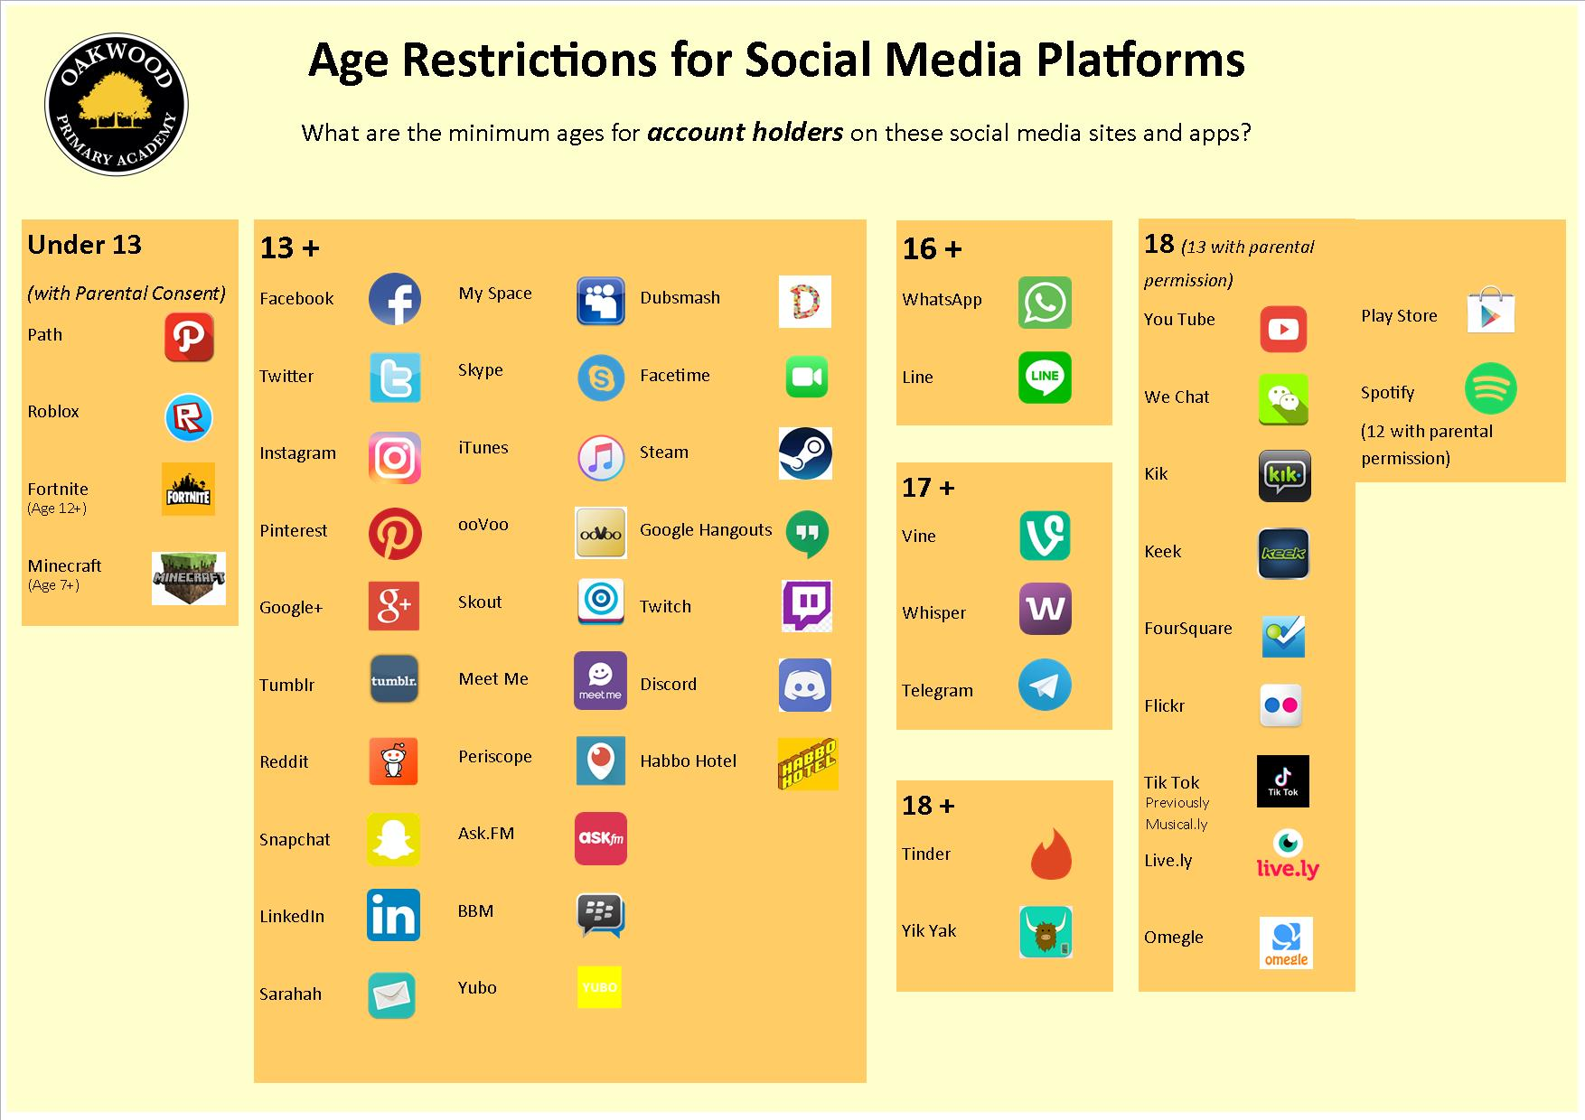

Slide 7
A little white lie…
We know that some parents give permission to their underage-children to join services like Facebook and help them to set up accounts. They see putting in a false date-of-birth in the registration form as a white-lie.
Ultimately, you need to decide if your child is equipped to deal with the interactions that arise from social networking.
The pressure to ‘fit in’ and/or to ‘be popular’ can be intense. Romance, group dynamics, and bullying can contribute to creating choppy waters that even adults find difficult to navigate.
We have a rough rule of thumb. Is your child old enough to go into the city centre by themselves on the bus or train at the weekend? If not, then they probably aren’t ready to go on Facebook

Slide 8
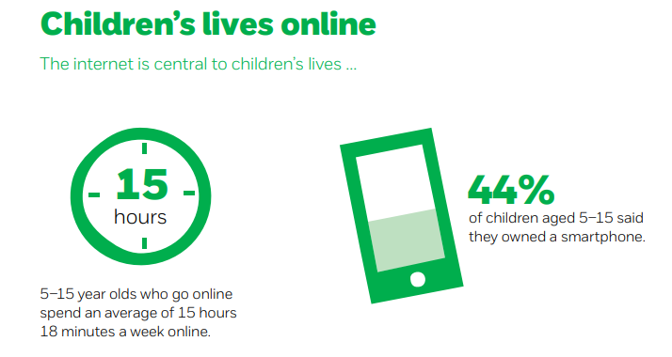
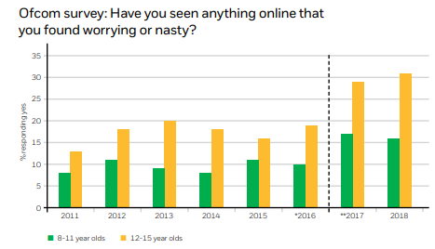
Statistics
16 per cent of surveyed primary school-aged children and 19 per cent of surveyed secondary school students said they had seen content which encouraged people to hurt themselves.

Slide 9
Children Online
Potential Risks
These are risks for adults too!
Cyber bullying
Grooming
Inappropriate content (violence, sexual, hatred etc)
Losing control over pictures and video / Giving out too much information online
Viruses, hacking and security
Not mature enough – consequences for their actions
Not mature enough – to distinguish between real and “fake news” / real lives vs. “social media lives.

Slide 10
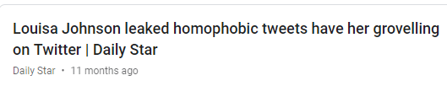






Louisa, 14
Consequences 4 year later
Louisa Johnson
Something your child says on social media NOW could have an effect on their future
Jack, 16
Consequences: 5 years later
Kevin, 32
Consequences: 8 years later
According to a 2018 Career Builder survey, 70 percent of employers use social media to screen candidates during the hiring process. 43 percent use it to check on current employees.
Donte, 14
Consequences: 7 years later

Slide 11
Manage Risk
Think about what your child likes to do online:
What are the potential risks?
How can you reduce the risk?
Cyber bullying
Grooming
Inappropriate content (violence, sexual, hatred etc)
Losing control over pictures and video / Giving out too much information online
Viruses, hacking and security
Not mature enough – consequences for their actions
Not mature enough – to distinguish between real and “fake news” / real lives vs. “social media lives.

Slide 12
Risks of Gaming
Many online games have communication features which allow their users to interact anonymously e.g. Minecraft (all devices) and World of Warcraft (PC)
Cyberbullies may harass fellow gamers and online scam artists may promise virtual goods in an effort to get credit card information e.g. World of Warcraft
Some game consoles allow internet access as well, so it is important to be aware of their communication features.
If there is a credit card linked to the account (presumably yours!), there is the chance that virtual goods can be purchased – accidentally or otherwise!

Slide 13
Tips
Keep the computer in a high-traffic area of your home.
Remember that Internet technology can be mobile, so make sure to monitor mobile phones, gaming devices, and laptops. Encourage children to use ipads/mobiles in shared areas (or leave doors open)
Establish limits for which online sites children may visit and for how long.
Surf the Internet with your children and let them show you what they like to do online.
Know who is connecting with your children online and set rules for social networking, instant messaging, e-mailing, online gaming, and using webcams.
Check the browser search history on a regular basis.

Slide 14
Communication
Be a part of their online life; involve the whole family and show an interest. Find out what sites they visit and what they love about them.
Don’t rely on filters. No filter or parental controls tool is 100% effective, and many of the risks that young people face online are because of their own and other’s behaviour.

Slide 15
Discussion Starters
What are your favourite things to do online?
What is personal information? Why should you keep it private?
What could you do to be safer online?
What would you do if anyone online asked to meet you face-to-face?
Besides me, who do you feel that you can talk to if you are in a scary or uncomfortable situation?
Do you use DM or chat rooms to talk to your friends and others?
How many people do you have on your buddy/contact list(s) and who are they?
Have you ever chatted with someone you did not know in real life? What kinds of things did you talk about?
Do you know how to block others in chat rooms and IM? Can you show me how to do this?
Go to http://www.netsmartz.org/InternetSafety for further examples.

Slide 16
Parental Controls
Internet Providers
The 5 big internet providers in the UK – BT, Sky, TalkTalk, Plusnet and Virgin Media - provide their customers with free parental controls.
These providers offer filter levels e.g. BT provides ‘light’, ‘moderate’ or ‘strict’ filter levels.
Parents can :
customise their parental controls.
allow and block specific sites.
set filter times.
set limits for time online.

Slide 17
Parental Controls
Gaming Devices
Parental controls can also be set up on games consoles, such as Playstation, Xbox and Nintendo Wii.
Restrict games based on age rating. Don’t cave in to peer pressure! If ALL parents stick together, children will be safer!
Restrict time spent e.g. On the Xbox 360 activate the “Family Timer” to limit the total amount.
Control your child’s friend requests so you know who they’re playing with online.
Restrict online user-to-user communication and the exchange of user-generated content.

Slide 18
Parental Controls
Smartphones
Capable of a range of internet functions: social networking, listening to music, playing games, browsing the internet, checking emails, taking photos and videos and watching TV.
Out and about, users access the internet via 3G connection which is provided by the data allowance in their mobile contract.
All mobile network providers provide parental controls.
Some will have these on as default, but others you will need to request to be turned on.
e.g. Tesco Mobile and O2 have a parental control option to ensure that only websites they have classified as suitable for children under 12 can be accessed. Contact your service provider to find out about filtering options.

Slide 19
What to do if your child sees inappropriate material online
Don’t overreact if your child tells you about something they have seen. You might feel shocked and an­gry but by dealing with it calmly your child will know they can turn to you again.
Keep records of abusive messaging (Screen shot)
Report abusive or inappropriate behaviour to the website and if serious, to the police.
If you come across illegal content, such as images of child abuse, you can report this to the Internet Watch Foundation at www.iwf.org.uk.

Slide 20

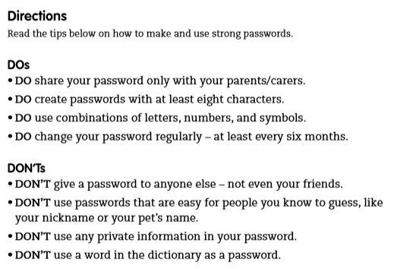
What are we teaching children?

Slide 21
How can I enjoy games online
and keep safe?
S
M
A
R
T
afe
eeting
cceptable
eliable
ell

Slide 22

Follow the SMART rules
Keep your personal information safe!
If you wouldn’t say it to a stranger on the street, don’t share it with strangers on the internet…

Slide 23
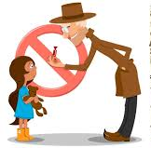
Follow the SMART rules
Don’t meet up!
Online games can be a great place for chatting to your friends. Always know who you are talking to. If an adult who you don’t know ever asks you to meet up, say no and report it…

Slide 24

Follow the SMART rules
Accepting
Think before you accept something from someone online e.g. a file, a download, a picture etc. It may contain a virus. If you don’t know who it’s from, and it has an attachment… DELETE IT!

Slide 25

Follow the SMART rules
Reliable
Not everyone online is trustworthy. Somebody may be lying about their age and who they are. Make sure you know who you are talking to and use reputable sites and services to protect you and your computer.

Slide 26
Follow the SMART rules
Tell
Tell a parent, carer or trusted adult if someone, or something makes you feel worried or uncomfortable online. Also, tell someone if a friend of yours needs help online too.

Slide 27
Useful Websites
www.saferinternet.org.uk/advice-and-resources/a-parents-guide/internet-enabled-devices
www.kidsmart.org.uk/beingsmart
www.childnet.com/resources/parental-controls
https://www.thinkuknow.co.uk/parents/Primary/
http://www.netsmartz.org/Parents

Slide 28
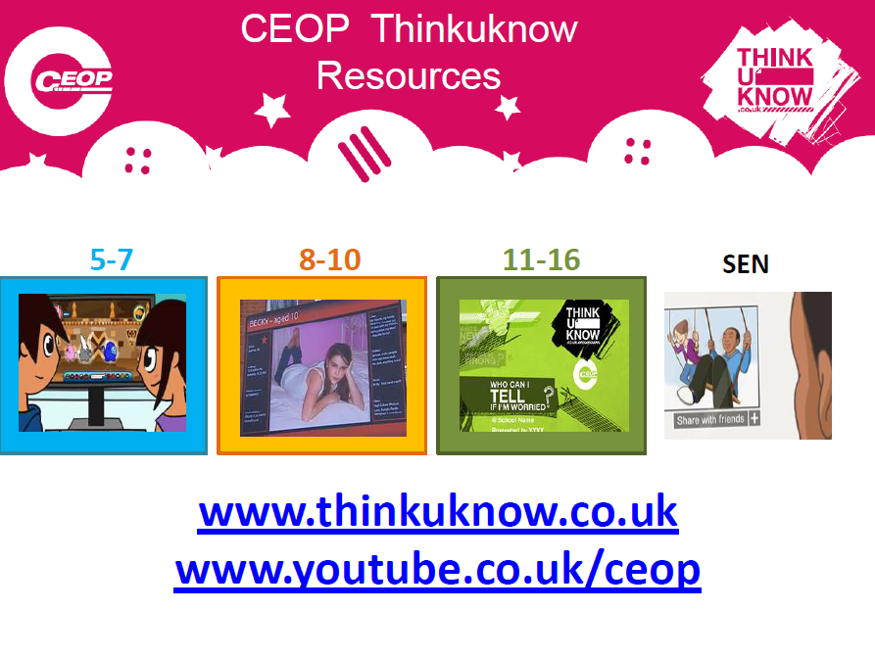

Slide 29
Any Questions?

