Slide 1

St David’s CIW Primary School
Hwb & E-safety Information Session.
18th March 2019
Mr Norman & Digital Leaders

Slide 2
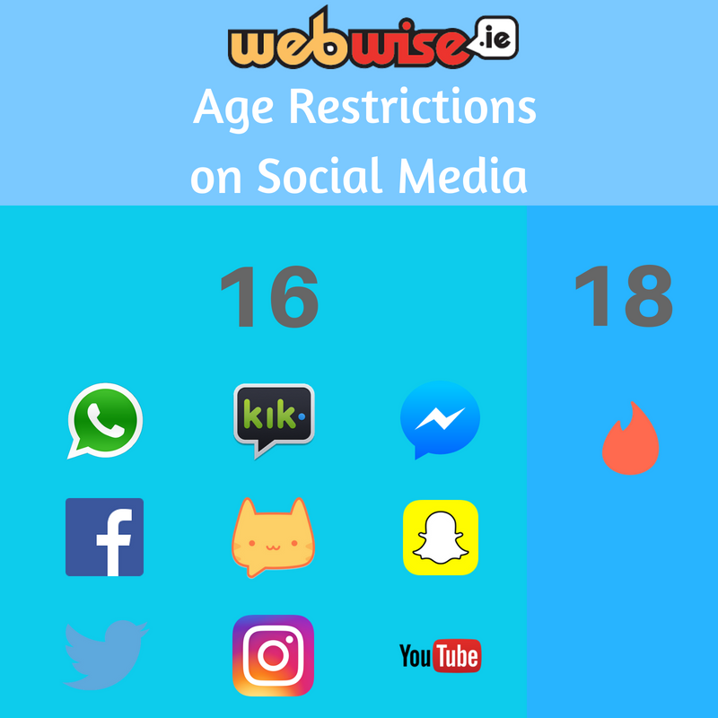
We know that some parents give permission to their underage-children to join services like Facebook and help them to set up accounts. They see putting in a false date-of-birth in the registration form as a white-lie.
Ultimately, you need to decide if your child is equipped to deal with the interactions that arise from social networking.
The pressure to ‘fit in’ and/or to ‘be popular’ can be intense. Romance, group dynamics, and bullying can contribute to creating choppy waters that even adults find difficult to navigate.
We have a rough rule of thumb. Is your child old enough to go into the city centre by themselves on the bus or train at the weekend? If not, then they probably aren’t ready to go on Facebook

Slide 3
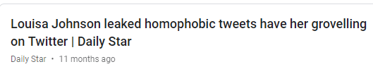


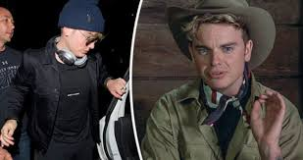
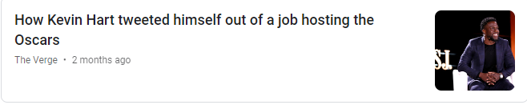


Louisa, 14
Consequences 4 year later
Louisa Johnson
Something your child says on social media NOW could have an effect on their future
Jack, 16
Consequences: 5 years later
Kevin, 32
Consequences: 8 years later
According to a 2018 Career Builder survey, 70 percent of employers use social media to screen candidates during the hiring process. 43 percent use it to check on current employees.
Donte, 14
Consequences: 7 years later

Slide 4

Key messages –
What should your child remember?
Choose websites which they trust / know they are safe
Recognise their ‘Digital Footprint’
Keeping personal information private
Respecting others online as your would in real life
Plagiarism
Understanding spam
Consider how images my be altered – distort our perceptions

Slide 5


What have we been doing?
Lots of digital learning and work on Hwb has been trialled for the past term.
Teaching e-safety and digital citizenship has been our main concern within this time to ensure the children are equipped and are aware of the rules and how to relate to each other online.
Also their safety online generally has been explored through the new curriculum.

Slide 6
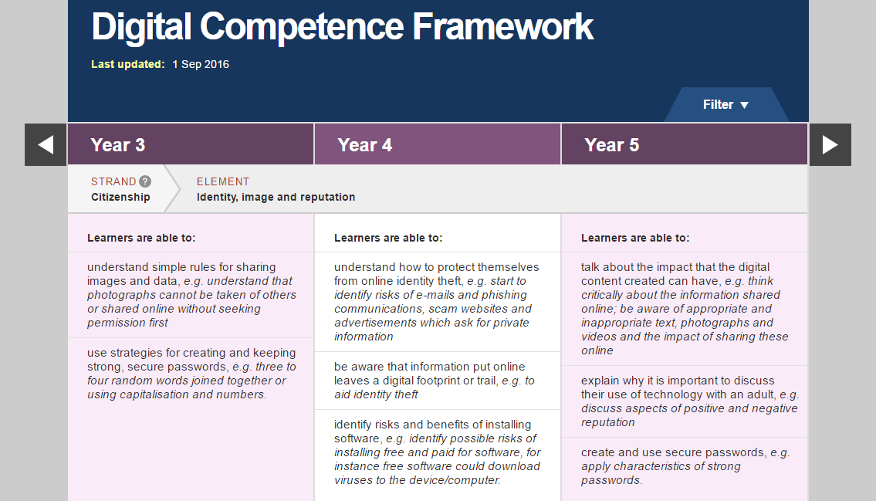
Why have we started using Hwb as a learning platform?
It is a fantastic, free resource; which very quickly will improve your children's digital skills.
It allows us as a school to develop your child's digital competency and literacy skills, in line with the new DCF (Digital Competency Framework), which has been released by the Welsh Assembly Government, following the Donaldson Report.

Slide 7

What is ?
A digital "learning platform" designed to allow all pupils and teachers in Wales greater access to online resources. The bilingual scheme, called Hwb, allows users to access and safely share information and is accessible from any internet-enabled device.
Hwb hosts a national collection of digital resources to support learning and teaching for learners aged 3 to 19 in Wales. These include:
resources created or commissioned by the Welsh Government and/or its agents.
resources licensed or bought by the Welsh Government.
resources made available by ‘trusted sources’.
resources created by teachers.

Slide 8

How can you and your child access HWB?
All children have been assigned log in details. Class teachers have access to the log in information. Only Mr Norman can reset passwords.
You can then access HWB on a laptop, desktop computer, ipad or Android tablet.
When working on a laptop or desktop computer, Hwb will work better if you access it through a 'Google Chrome,' web browser.
If you do not have a google chrome browser on your
computer; it is free and easy to download off the internet.
Type – Google chrome download into your Internet search engine and select 'Chrome for Desktop-Google.' Then click on the blue button, which says 'Download Chrome.'

Slide 9
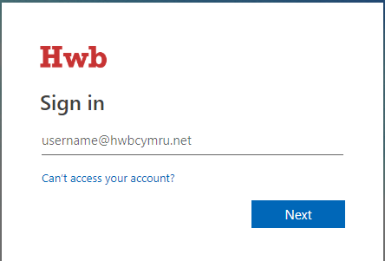
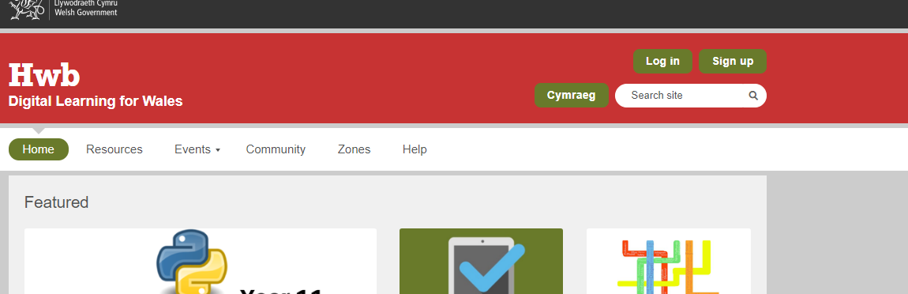
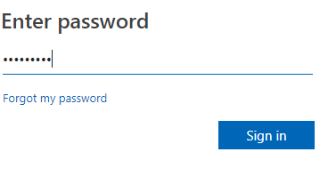
You then need to go to the Hwb website, click on the green log in button and then enter your child's username and password.….....
https://hwb.wales.gov.uk/

Slide 10
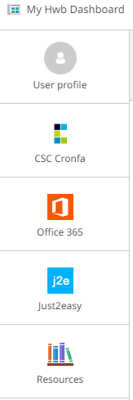
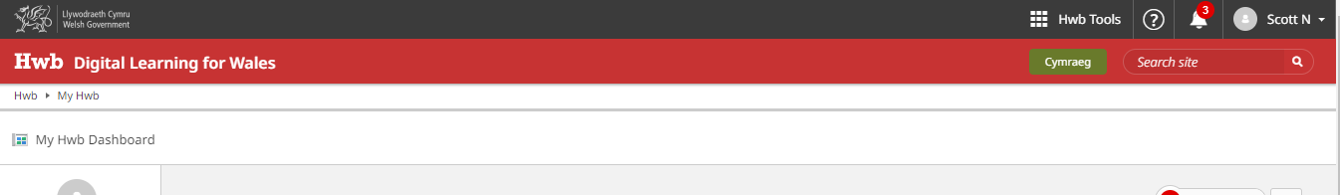
Your child will then be logged in and will have access to all lots of resources...
https://hwb.wales.gov.uk/
Click on the squares button to access the office 365 – your child's email, OneDrive and Microsoft office packages.

Slide 11
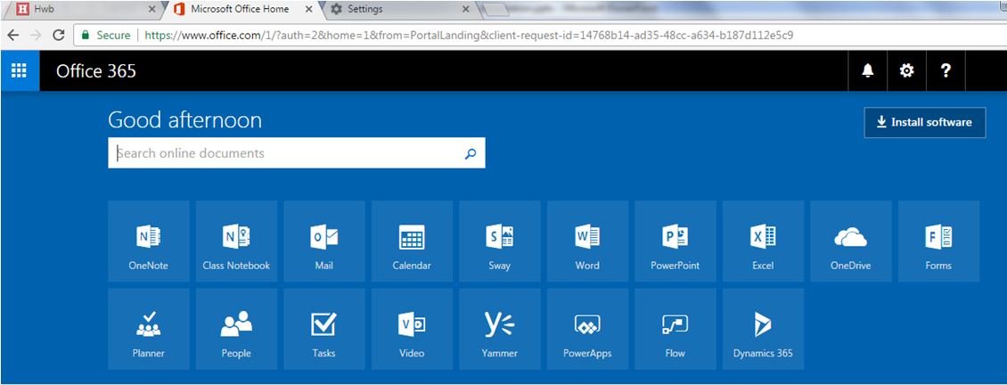
The following screen will load , which shows you all of the Office packages that are available to your child.

Slide 12
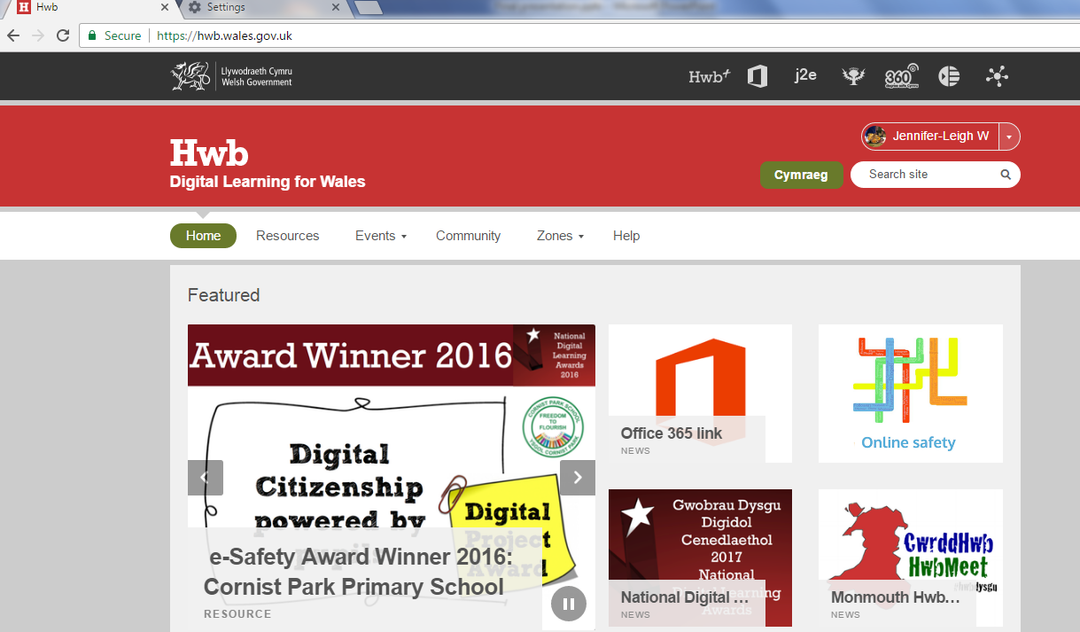
Your child will then be logged in and will have access to lots of resources...
https://hwb.wales.gov.uk/
Click on the j2e (Just2easy) button and your child will have access to lots of apps.

Slide 13
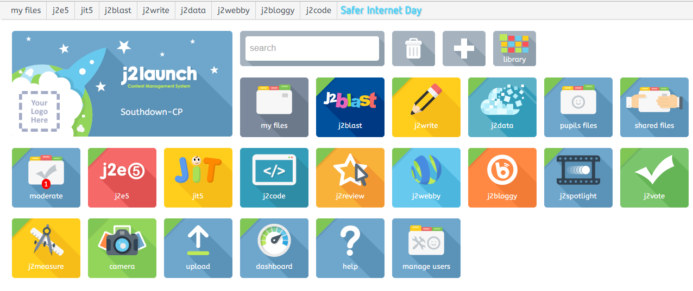
J2e Just to Easy (j2launch)
J2Blast
Pupil Files
J2Coding
J2Vote / J2Data
This provides the children with access to a variety of coding resources through j2code.

Slide 14

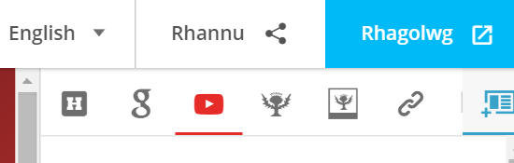
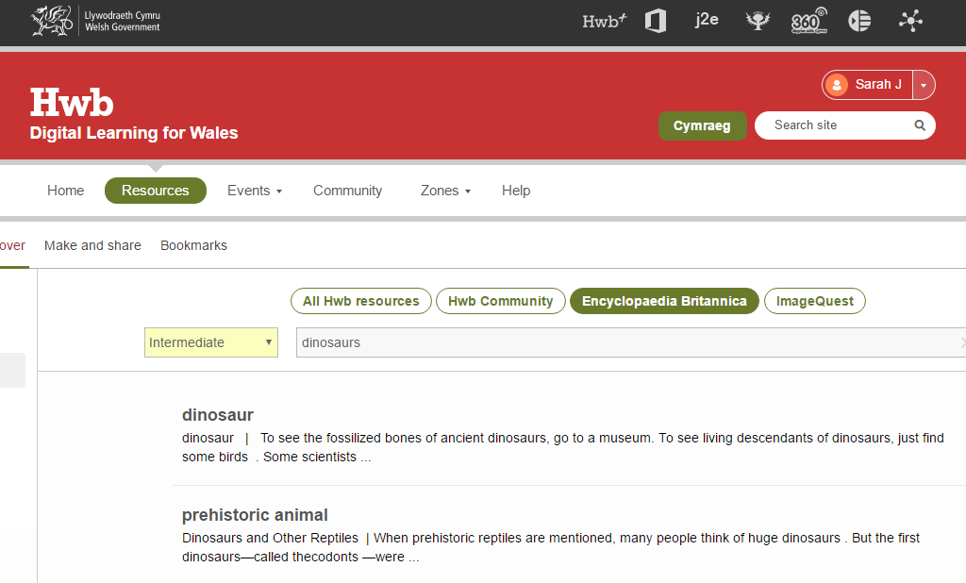

Encyclopedia Britannica & Image Quest
This is where your child can do some safe Internet research and you are also able to change the reading level between foundation, intermediate and advanced. They can also search for copyright free images in the image quest.
HWB Playlists – This is where the children can gather different resources together for research purposes from a variety of places, such as; Hwb, google, You tube, Britannica and external websites.

Slide 15
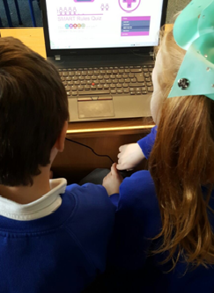
What does your child use Hwb for in school?
Research.
Use the Microsoft Office packages to produce and
present a variety of different media.
Collaborate on documents with their peers.
Coding – create a set of instructions to create designs or
solve problems.
A storage device for all of their documents produced on
Hwb and i pad APPs. E.g. Picollage, book creator etc.

Slide 16
What will your child be using Hwb for at home?
Educational purposes
This might include:
Homework, as directed by their teacher.
Research.
As a storage device for school work.
Email.
Practice their coding skills on j2e and have fun!

Slide 17

What does my child need to remember?
To always adhere to our online rules
Follow the SMART message:

Slide 18
What do you do if you have problems with
Hwb at home?
If you have any problems, you can:
Talk to your child's class teacher, who will liaise with me.
We will strive to support you as best as we can!
I will also attach this PowerPoint on the Hwb page on our school website, for you to make reference to.

Slide 19
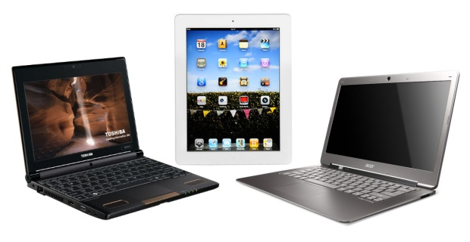
Please take the time to have a look at the ipads and laptops and have a look at what is available to your child.
Thank you for taking the time to come today. We appreciate your continued support!

Slide 20

Help us to prepare your child as critical and logical thinkers for a ‘Digital World!’

