Slide 1
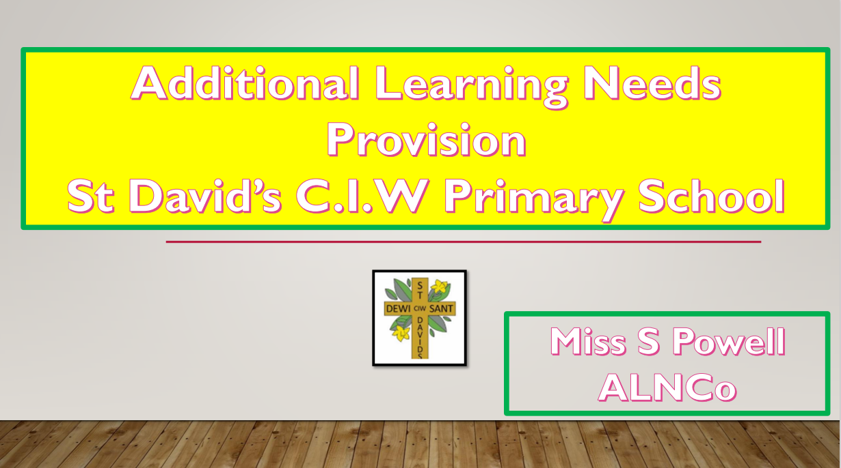
Miss Morgan
ALNco

Slide 2
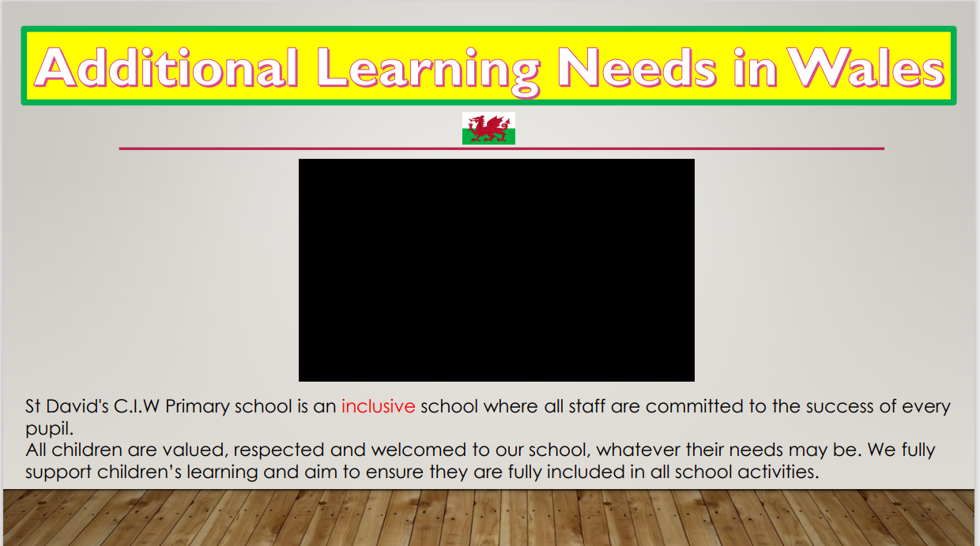
https://youtu.be/00gHqzWowPg

Slide 3
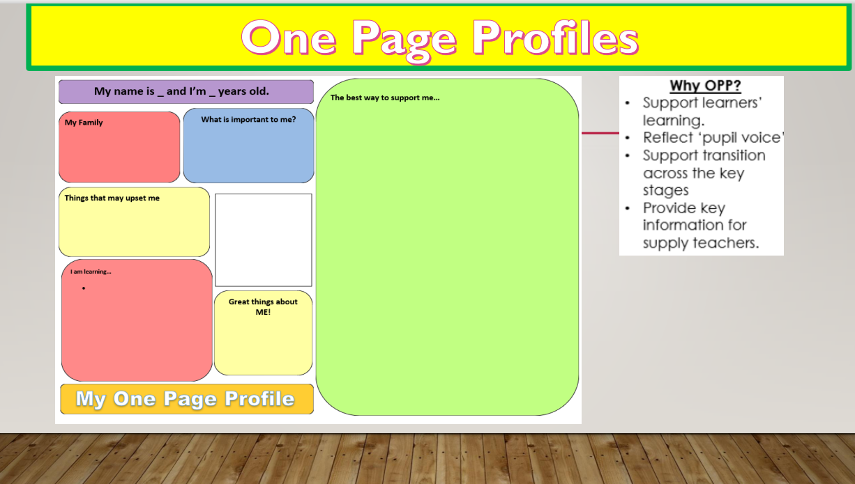

Slide 4
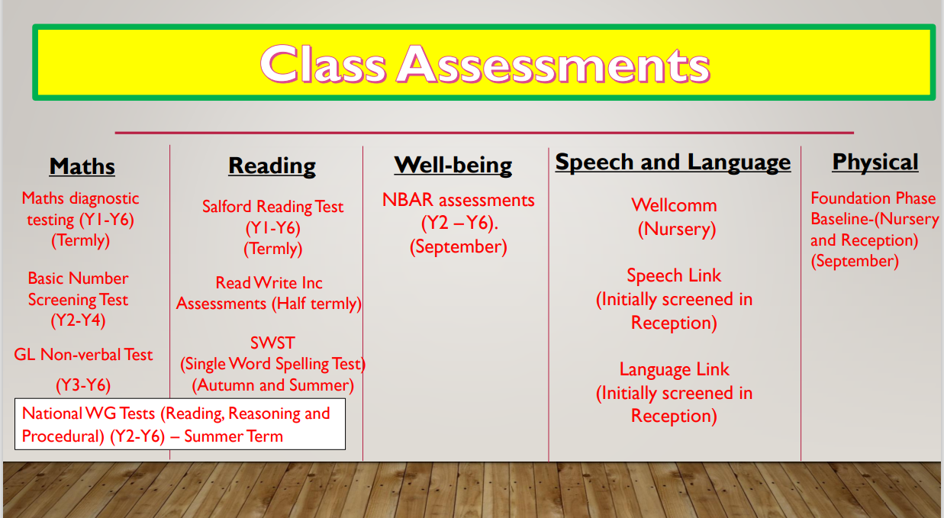

Slide 5
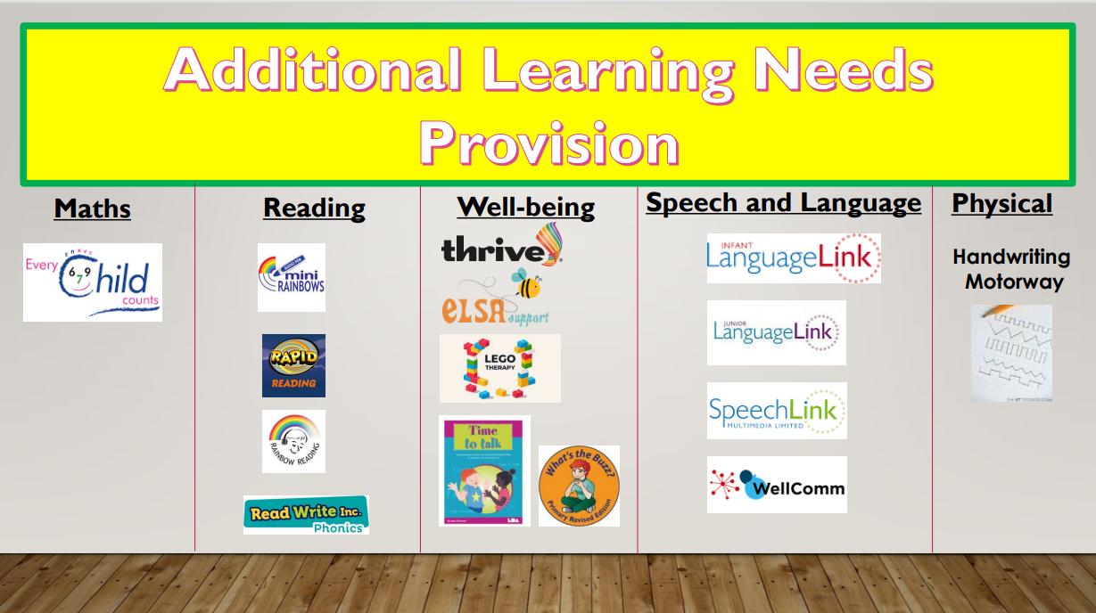

Slide 6
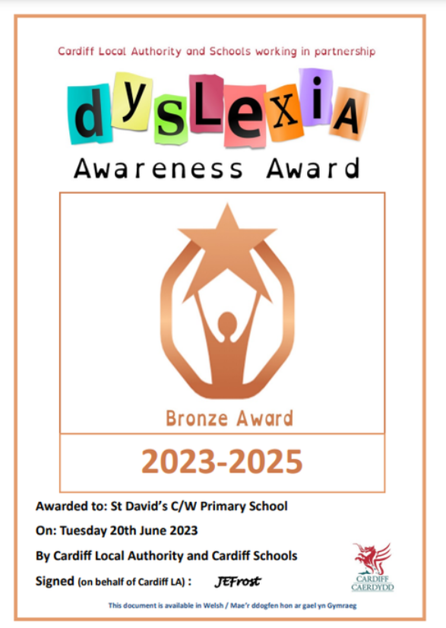
We have achieved our Dyslexia Awareness Award last year.
We have lots to celebrate within the ALN umbrella at St David’s with our highly qualified and consistently trained staff and a consistent awareness of the needs and abilities of the children in our care.
We do our utmost to go above and beyond for children, parents and guardians with our school community.

Slide 7
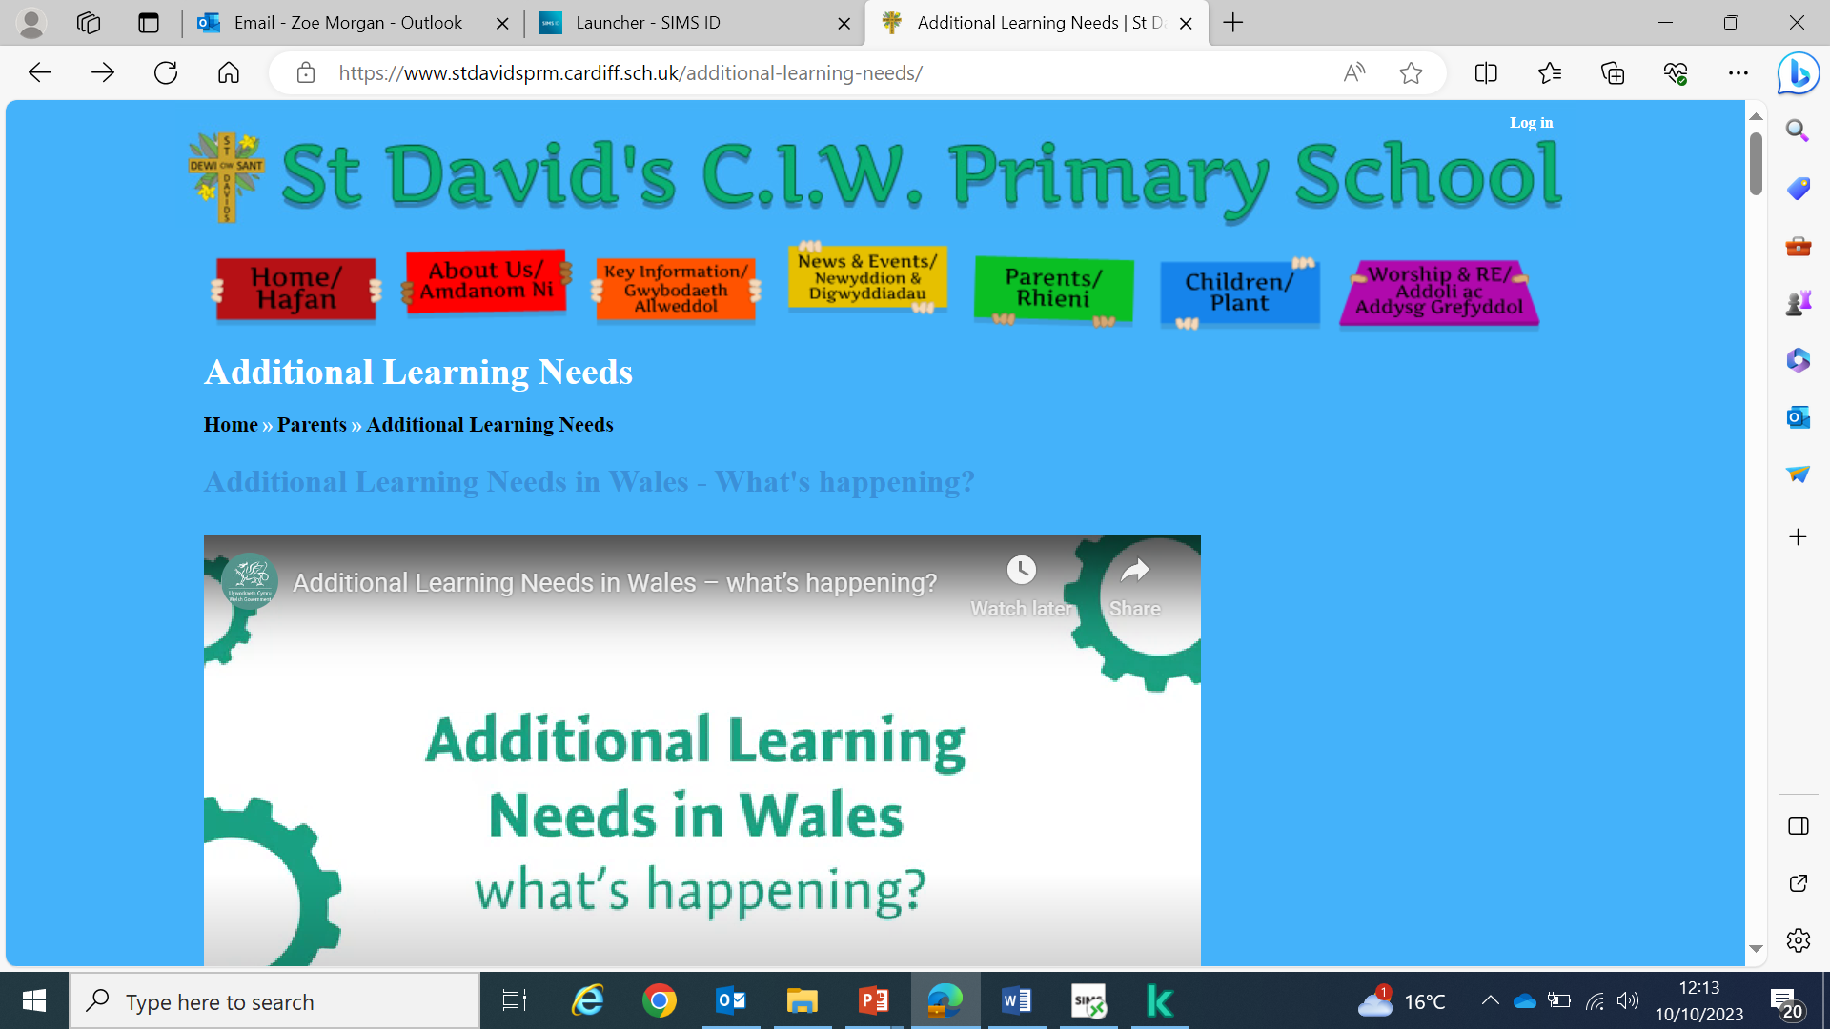

Slide 8
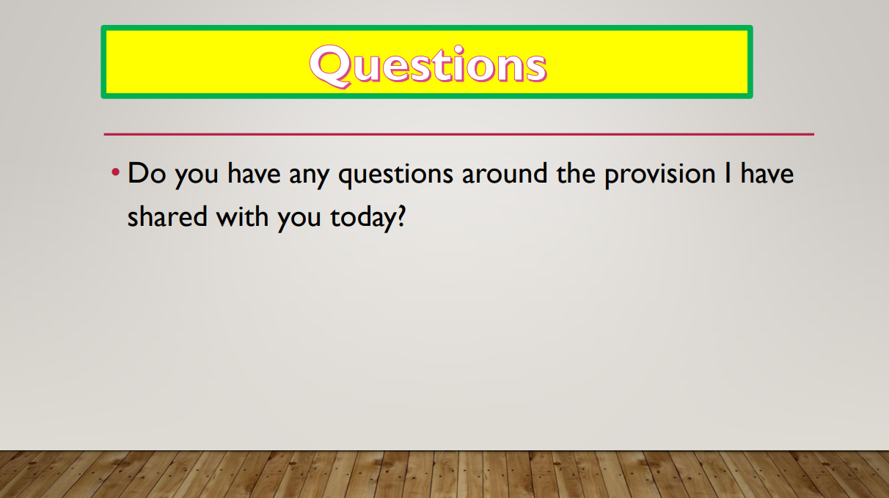
zmorgan@stdavidsprm.Cardiff.sch.uk

